Slide 1

Designing a Personal Finance App Mint.com
Presented by:
Md. Abul Kalam Azad - 1425
Mahshin Islam - 1428
Kazi Nahid - 1437
Md. Nazmus Shakib - 1452

Slide 2

CONTENTS
2. High-Level Architecture
3. Designing Core Components
1. Problem Scope & Goal
4. Scalability & Reliability
5. Performance Optimization
6. Security Considerations
7. Design Trade-offs

Slide 3

01
Problem Scope & Goal

Slide 4

Problem Scope & Goals Use Cases:
Connect user to financial account(s)
Extract & update transactions daily
Categorize transactions (manual override allowed)
Monthly spending analysis by category
Recommend & set budgets (manual override)
Notifications when near/exceeding budget

Slide 5
Problem Scope & Goals Constraints and Assumptions:
Traffic is not evenly distributed
Automatic daily update of accounts applies only to users active in the past 30 days
Adding or removing financial accounts is relatively rare
Budget notifications don't need to be instant
10M users
10 categories/user → 100M budget items
30M financial accounts
5B transactions/month
500M reads/month
Write-heavy system (10:1 write-to-read)

Slide 6
Data Volume
Estimated size per budget record:~43 bytes
user_id: 8 bytes
category_name: 20 bytes
budget_amount: 5 bytes
created_at: 5 bytes
updated_at: 5 bytes
Per-user budget storage: 43 × 10 = 430 bytes
10M users → 4.3 GB total budget data

Slide 7
Data Volume Estimated size per transaction: ~50 bytes
user_id: 8 bytes
created_at: 5 bytes
seller: 32 bytes
amount: 5 bytes
Monthly:
50 bytes × 5B transactions = 250 GB/month
3 Years:~9 TB total storage

Slide 8
Traffic Estimates
2,000 transactions/sec (avg)
200 read requests/sec (avg)
Conversion guide:
1 req/sec → 2.5M req/month
40 req/sec → 100M req/month
400 req/sec → 1B req/month

Slide 9

02
High-Level Architecture

Slide 10
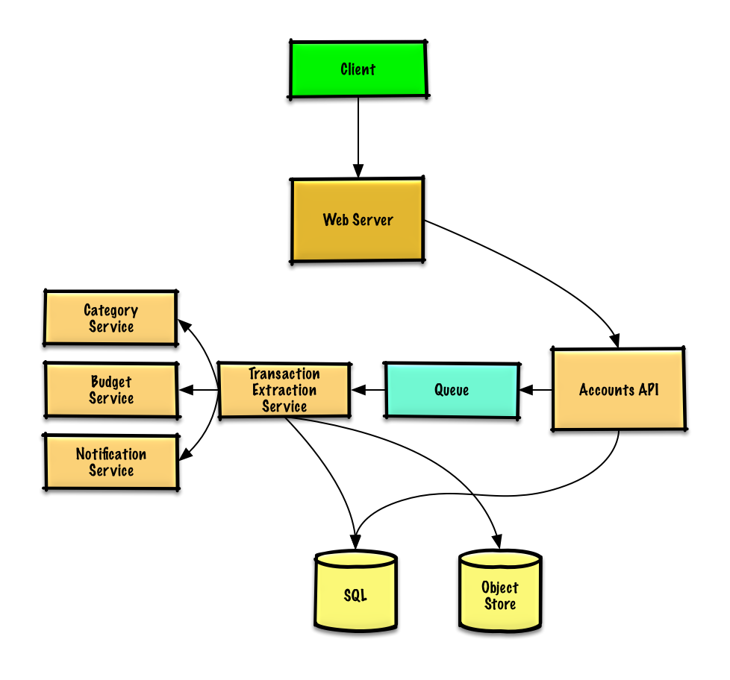

Slide 11

03
Designing Core Components

Slide 12
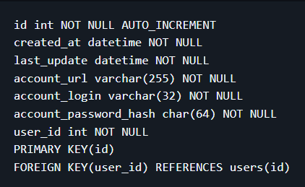
Use Case 1: User connects to a financial account
Flow: Accounts Table Schema:
Client sends account connection request
Web Server acts as a reverse proxy and forwards request
Accounts API Server processes request
Updates accounts table in SQL Database
Store info for 10 million users in a relational database
Indexes on: id, user_id, created_at
Speeds up lookups to logarithmic time
Keeps frequently accessed data in memory
Use Remote Procedure Calls (RPC) between services

Slide 13
Use case 2 : Transaction Extraction
When triggered: • User links account • User refreshes manually • Daily auto-refresh for active users
Data Flow:
Client → Web Server → Accounts API
Accounts API places job in Queue (SQS/RabbitMQ)
Transaction Extraction Service asynchronously:
Fetches transactions from financial institution
Stores raw logs in Object Store
Categorizes transactions
Calculates monthly spending
Updates DB tables (transactions, monthly_spending)
Sends notification via Notification Service (async)

Slide 14
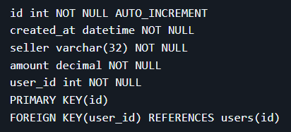
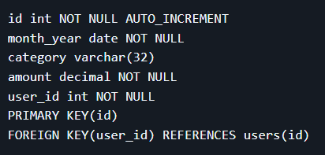
Use case 2 : Transaction Extraction
Transactions Table Schema
Monthly_Spending Table Schema
Transactions Table: Indexed on id, user_id, created_at
Monthly Spending Table: Indexed on id, user_id
Category Service: • Pre-seeded seller-to-category map (~50k sellers, ~12MB RAM) • Use crowdsourced overrides for unknown sellers • Fast O(1) lookup with heap structure

Slide 15
Use Case 3 : Recommends a Budget
Budget Recommendation Service Overview
Start with a generic budget template based on user income tiers
Avoid storing all budget items (~100 million); only store user overrides
Overrides stored in budget_overrides table
Example budget allocations:
Housing: 40% of income
Food: 20%
Gas: 10%
Shopping: 20%

Slide 16
Use Case 3 : Recommends a Budget
Data Aggregation Strategy
Use SQL queries on the transactions table to generate monthly_spending aggregates
Alternatively, use MapReduce on raw transaction logs to:
Categorize transactions
Calculate monthly spending per category
MapReduce reduces load on SQL database, suitable for large datasets
Re-run analysis when user updates budget category

Slide 17
Use Case 3 : Recommends a Budget
MapReduce Job: Spending By Category
Input log format (tab-delimited): user_id timestamp seller amount
Mapper:
Parse log lines
Categorize seller
Extract year and month from timestamp
Emit key-value pairs: (user_id, year-month, category) → amount
Reducer:
Sum amounts per key
Emit total spending per user-category-month

Slide 18

04
Scalability & Reliability

Slide 19
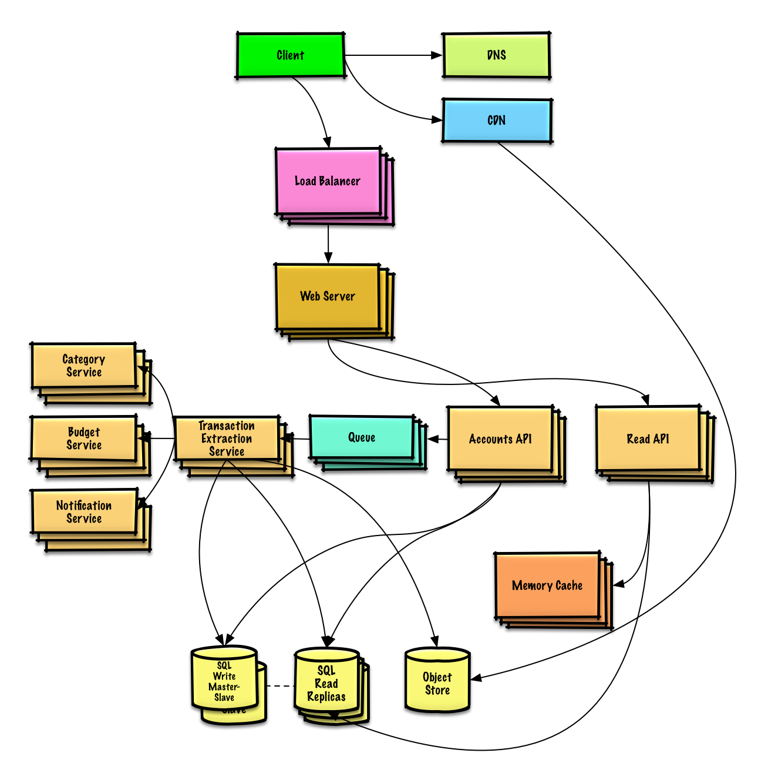

Slide 20
Scalability & Reliability
Scalability
Horizontal Scaling:
Multiple Web Servers behind a Load Balancer to distribute traffic.
Read Replicas for SQL databases to handle high read loads (200+ requests/sec).
Data Partitioning:
Sharding by user_id to distribute transaction data across databases.
Federation to separate tables (e.g., transactions, budgets) into dedicated databases.
Caching:
Redis/Memcached for frequently accessed data (e.g., monthly spending, recent transactions).
CDN for static content (e.g., budget templates, UI assets).
Asynchronous Processing:
Message Queues for transaction extraction and budget notifications.
MapReduce for batch processing of transaction analytics.

Slide 21
Scalability & Reliability
Reliability
Redundancy:
Multi-AZ Deployments for databases and services to ensure fault tolerance.
Master-Slave Failover for SQL databases to handle write failures.
Data Durability:
Object Storage (e.g., S3) for raw transaction logs (250 GB/month).
Backups for SQL databases and analytics data.

Slide 22

05
Performance Optimization

Slide 23

Performance Optimization
Database Optimization
Indexing
Data Partitioning
Caching
In-Memory Cache (Redis/Memcached)
CDN for Static Assets
Asynchronous Processing
Queue-Based Workflows
Batch Processing
Latency Reduction
Edge Caching
Lazy Loading

Slide 24

06
Security Considerations

Slide 25


Security Considerations
Data Protection
Encryption:
TLS/SSL for all communications(In Transit) .
AES-256 for sensitive data(At Rest)
Authentication & Authorization
Multi-Factor Authentication (MFA)
OAuth 2.0 for third-party integrations
Role-Based Access Control (RBAC)
Threat Mitigation
Rate Limiting:
Block brute-force attacks
DDoS Protection:
Use Cloudflare/AWS Shield

Slide 26
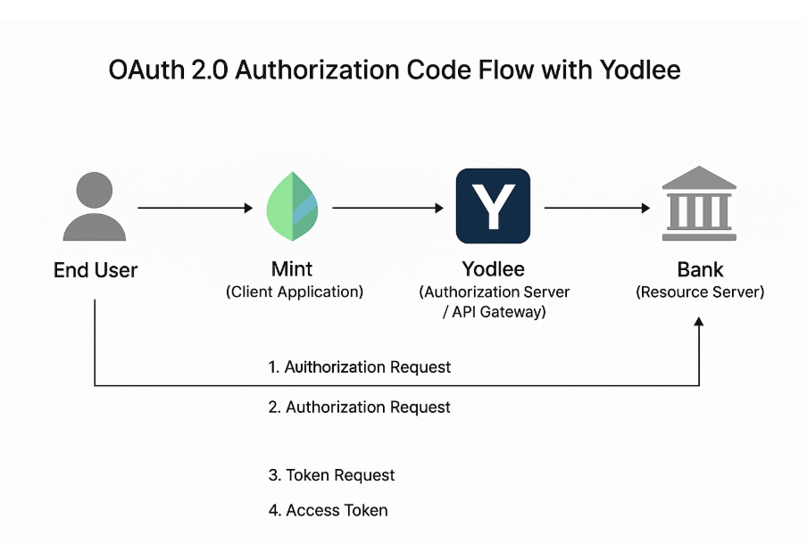
Threat Mitigation
Rate Limiting:
Block brute-force attacks
DDoS Protection:
Use Cloudflare/AWS Shield
Regular Audits:
Penetration testing and vulnerability scans

Slide 27
07
Design Trade-offs

Slide 28

Design Trade-offs Overview
Third-party Aggregator vs In-house Connectors
Strong Consistency vs Availability
SQL vs NoSQL
• Transactions ingestion benefits from eventual consistency
• SQL (Postgres) for user metadata/ACID needs, NoSQL (Cassandra) for high-throughput writes
• Third-party (Yodlee-like): faster time-to-market, less risk in storing credentials, but costs + dependency
Financial data must be accurate. Eventual Consistency(Synchronizing external financial data)
• In-house connectors: cheaper long term and flexible, but expensive to build and maintain
Real-time vs Batch Processing
Hot vs Cold Data Tiers
• Keeping everything hot simplifies reads but is very expensive
• Real-time categorization improves UX but increases compute cost

Slide 29
Third-party Aggregator vs In-house Connectors
Aspect | Third-Party Aggregator | In-House Aggregator
Speed of Implementation | Fast | Slow
Coverage | Wide (thousands of institutions) | Depends on development effort
Control | Limited | Full
Cost | Usage-based fees | High initial + maintenance cost
Maintenance | Outsourced | In-house
Security & Privacy | Shared responsibility | Full responsibility
Flexibility | Limited customization | High

Slide 30
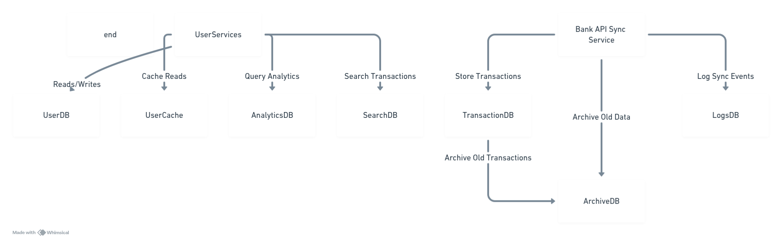
SQL vs No Sql
SQL:
User accounts & profiles (strong consistency)
Recent transactions (ACID, relational integrity)
Financial reports & complex queries (joins)
NoSQL:
Bank API data & logs (flexible schema)
Archived transactions & large datasets (scalable)
Analytics & dashboards (fast reads)
Caching & search (ultra-fast access)

Slide 31
Eventual vs Strong Consistency
Consistency Type | Use Case in Mint.com
Eventual Consistency | Synchronizing external financial data from banks and accounts (transactions, balances)
Strong Consistency | User profile changes, budgeting rules, transaction categorization done within Mint

Slide 32
Batch Processing vs Stream Processing
Where Mint uses Batch Processing:
Daily bank transaction syncs — pulling a big chunk of new data from user bank accounts.
Data analytics & reporting — calculating monthly spending, budgets, trends.
Data cleanup & enrichment — categorizing transactions, fraud detection, error corrections.
Why batch?
Efficient for large volumes of data.
Can use heavy, complex computations without worrying about latency.
Easier to manage consistency because all data is processed at once.
Where Mint uses Stream Processing:
Instant transaction updates — showing users new purchases immediately.
Real-time alerts — notifying suspicious activity, budget limits exceeded.
Syncing live bank API events where supported.
Why streaming?
Provides low latency user experience.
Enables real-time notifications and dashboards.
Keeps the system responsive and up-to-date.

Slide 33
Thank You

